Slide 1

SUMMER INTERNSHIP PROJECT
Understanding the Role of Geographical Distance in Wikipedia Translations
CONTRIBUTION
Under the supervision
of
Dr. Hazique Aetesam
Prepared by: Pranjay kumar
Roll_No: BTECH/15018/21
B.TECH(CSE) 2021-2025

Slide 2
Outline
Introduction
Problem Statement
Literature
Motivation
Proposed Methodology
Results and Discussion
Conclusion and Future Work
References

Slide 3

INTRODUCTION
Wikipedia is a free, collaborative online encyclopedia where users can edit and contribute articles on a wide range of topics.
Language translation on Wikipedia involves converting content from one language to another, often using tools like the Content Translation Tool, which provides machine translations that users can refine.
This process diminishes the language barrier and helps make information accessible to speakers of different languages
Language barriers lead to unequal access to online information, a big challenge in the digital age. This “digital language divide” hinders the global exchange of knowledge and has become a persistent problem within collaborative platforms that aim to democratize access.
Despite standing out as a major source of free and free access to knowledge, Wikipedia grapples with substantial content gaps across languages.

Slide 4
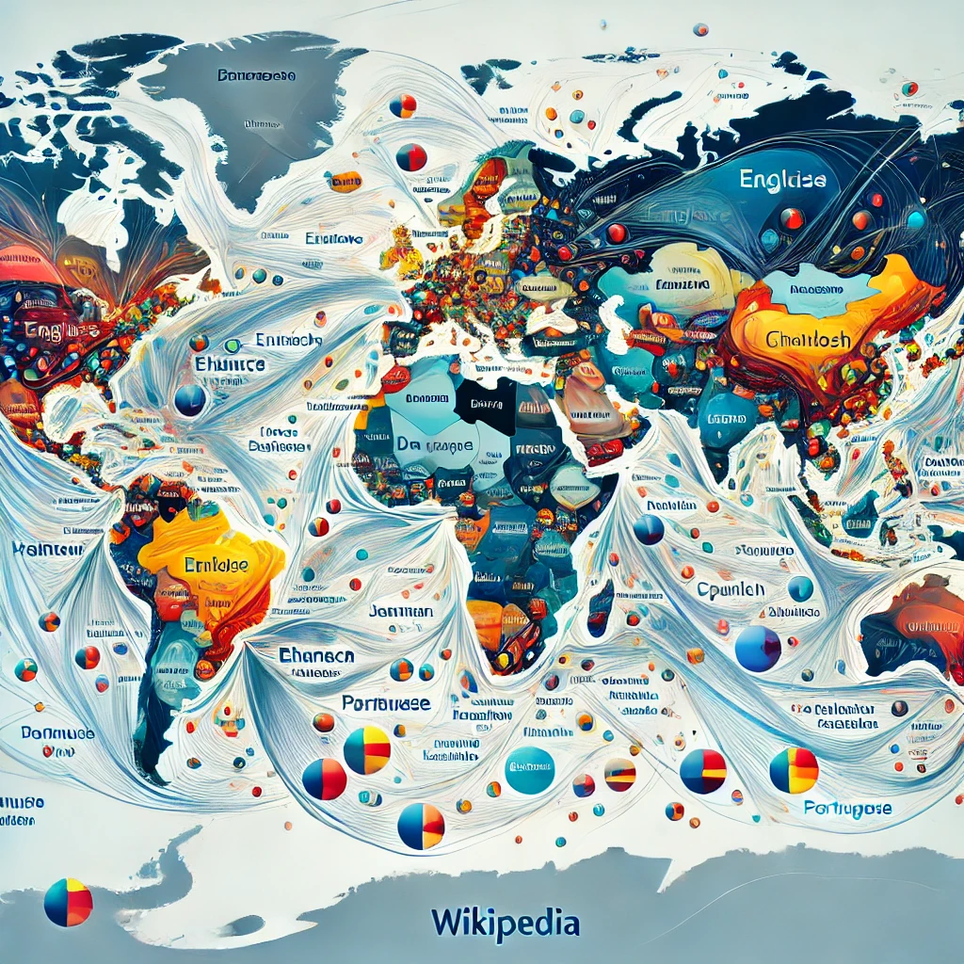
Problem Statement
To understand relation between the content translation and geographical distance.
The language is a very important parameter to understand the cross-cultural differences.
In Wikipedia, people often translate the content to different language to reduce the language gap.
In this study, we are trying to understand if the translation in Wikipedia has any impact of geographical distance or not.

Slide 5
LITERATURE
PAPER | CONTRIBUTION
The Promise and Pitfalls of AI Technology in Bridging the Digital Language Divide: Insights from Machine Translation on Wikipedia [1] | The integration of Google Translate led to a 149% increase in content production through translation. This was driven by increased productivity of existing editors and an expansion of the editor base.
In Search of the Ur-Wikipedia: Universality, Similarity, and Translation in the Wikipedia Inter-language Link Network [2] | The paper provides a comprehensive analysis of the inter-language link network in Wikipedia, shedding light on the dynamics of knowledge sharing, similarity, and translation across multiple languages and cultures.

Slide 6
PAPER | CONTRIBUTION
Using Wikipedia for Extracting Hierarchy and Building Geo-Ontology [3] | This paper presents a novel approach to extracting hierarchical geographical information and building a comprehensive geo-ontology using data from Wikipedia
Transforming Wikipedia into a Large Scale Multilingual Concept Network [4] | This paper significantly advances the field by providing a comprehensive and high-quality multilingual knowledge base derived from Wikipedia, offering valuable insights and tools for natural language processing and artificial intelligence applications.
What is Trending on Wikipedia? Capturing Trends and Language Biases Across Wikipedia Edition [5] | This paper contributes to the understanding of how different language communities engage with Wikipedia, offering a comprehensive method for capturing and analyzing trends and language biases in reader behavior.
Wikipedia Entities as Rendezvous across Languages: Grounding Multilingual Language Models by Predicting Wikipedia Hyperlinks [6] | This paper introduces a new way to improve Multilingual Masked Language Models (MMLMs) by using Wikipedia links. The main idea is to teach these models by having them predict links in Wikipedia articles. This method helps the models understand and use knowledge from Wikipedia, making them better at handling different languages.

Slide 7
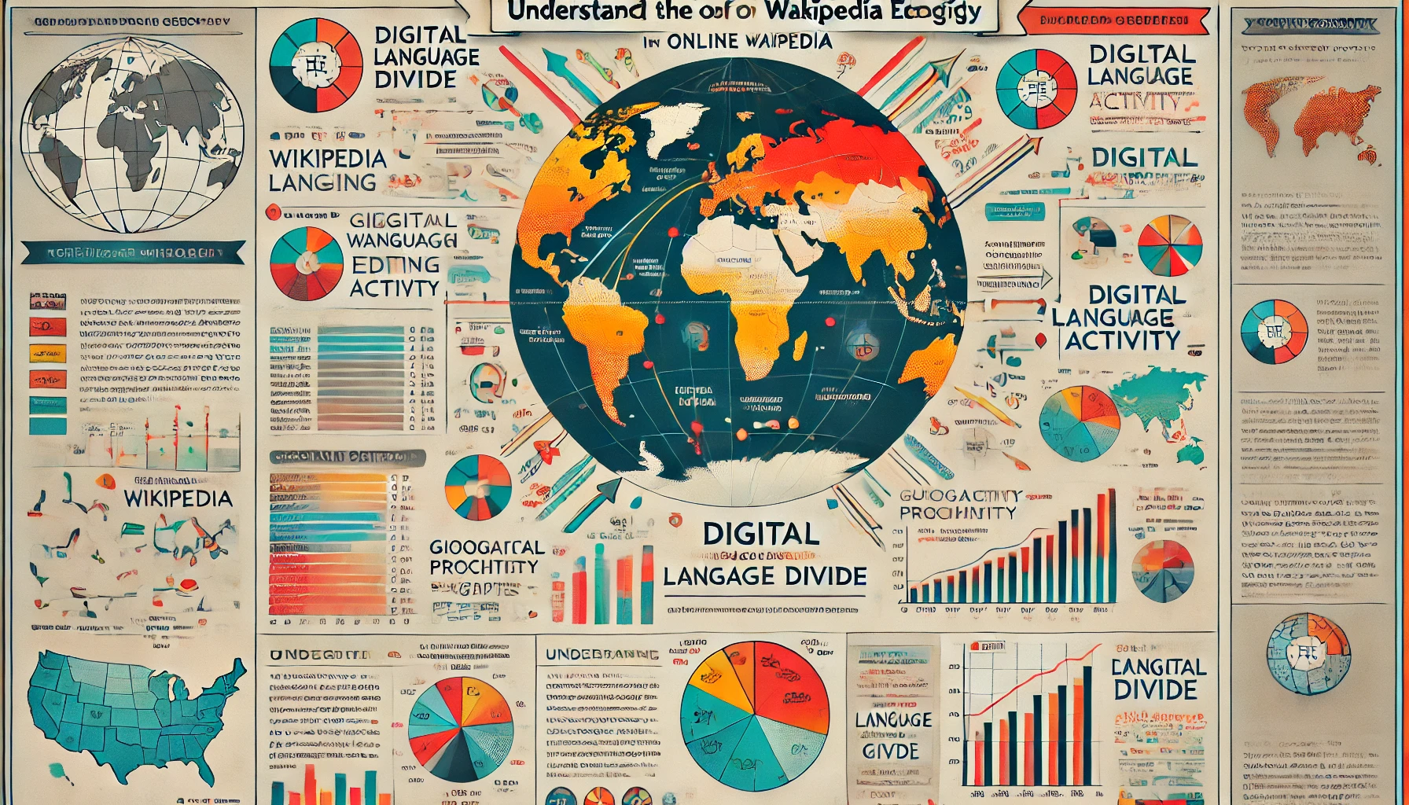
MOTIVATION
Past works have studied translation patterns in Wikipedia.
Past works have also claimed that there are cultural/social/geographical factors influencing translation patterns in Wikipedia.
But still there is a need of quantitative large scale study to better understand the direct role of geographical distance on translations.

Slide 8
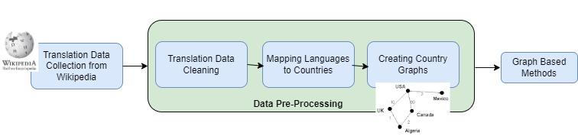
Contribution of the Work
Overview of our Proposed Methodology

Slide 9
Dataset Description
Dataset Source | Total #Translations | #Date Range | Total #Languages | Data Fields
Translation Data is collected from Wikipedia (Known as Wikidata) | 3614 | 2016-2022 | 184 | Wikidata ID,Language Edition,Creation Timestamp,Topics,Scores

Slide 10
Data Pre-processing
From both table we have language column in both table.
We match language merge both table and create a new table of country and ISO code
Language Name | ISO Code
Abkhazian | ab
Afar | aa
Afrikaans | af
Akan | ak
Albanian | sq
Country | Offical_language
Afghanistan | Farsi
Argentina | Spanish
Bangladesh | Bangla,English
Colombia | Spanish
India | Hindi, English
Table 4.1: Language with respective ISO Code
Table 4.2:Country with their respective Official language

Slide 11
Data Pre-processing
From given dataset we select language as source from which translation starts and target as were translation end at language.
Weight is calculated number of times conversion between source and target language.
Country | Language_Code
Algeria | ar
Argentina | en
Bangladesh | en
Bhutan | dz
Brazil | en
Source | Target | Weight
en | sv | 266
sv | fr | 151
fr | nl | 276
nl | zh | 77
zh | es | 152
Table 4.3: Country with their language code
Table 4.4: Source,target language code with their respective Weights

Slide 12
Data Pre-processing
We compute geographical distance between country using python library geopy
Country1 | Country 2 | Weight | Geographical Distance
Vietnam | Estonia | 152 | 8082.784838458567
Estonia | Finland | 58 | 501.8130413188027
Palestinian territories | Denmark | 10 | 3277.570677032637
India | France | 11 | 7245.67339386197
India | South Africa | 12 | 8074.156288931303
Table 4.5: Countries with weight and their Geographical Distance

Slide 13
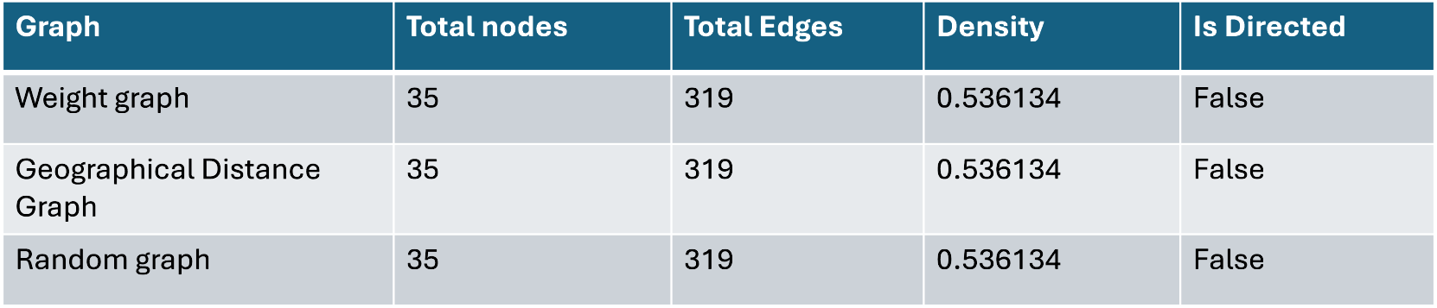
Created Graph Description
We have created three graphs, where each node is a country.
First graph edge weight as number of translation count between languages.
Second graph edge weight as geographical distance between country.
Third graph edge weight was random.
Table 4.6:Graphs with their respective properties

Slide 14
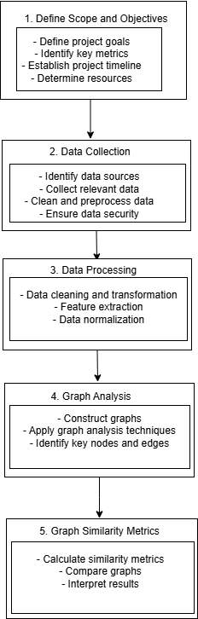
WORK FLOW

Slide 15
Graph Comparison Methods
Clustering: We applied louvain clustering algorithm.
The Louvain clustering algorithm is a popular method for detecting communities in large networks. It is based on the optimization of modularity, a measure of the strength of division of a network into clusters. The algorithm works in two phases:
i. Modularity Optimization: Initially, each node is assigned to its own community. The algorithm then iteratively reassigns nodes to communities in a way that maximizes the modularity gain. This phase continues until no further improvement can be made.
ii. Community Aggregation: Once the modularity is optimized locally, each community is treated as a single node and the process is repeated. This hierarchical aggregation continues until the modularity reaches a maximum and does not improve with further aggregation.
Graph Distance Metrics: We took two graph at a time weight-geographical,weight-random and geographical-random and compare these three combination graph distance metrics.

Slide 16
EXPERIMENTAL RESULTS(CONTINUED)
Distance metric | Weight-Random | Weight-Geographical | Geographical-Random
QuantumJSD | 0.7063616858599189 | 0.9221009671071541 | 0.5502062400241473
DegreeDivergence | 0.0 | 0.0 | 0.0
JaccardDistance | 0.0 | 0.0 | 0.0
Hamming | 0.0 | 0.0 | 0.0
HammingIpsenMikhailov | 0.008314013663142106 | 0.6450801654474845 | 0.7975143216584212
Frobenius | 0.9996113709563296 | 0.9875963397899536 | 0.9904400905551395
NetLSD | 0.0 | 0.0 | 0.0
GraphEdit | 0.0 | 0.0 | 0.0
Spectral | 122.08084172522838 | 1.2537139619256352 | 120.84270048539591
ShortestPath | 0.0 | 0.0 | 0.0
Graph distance metrics are essential for understanding the structure and connectivity within graphs.
They help quantify the distance between nodes and provide insights into various graph properties.

Slide 17
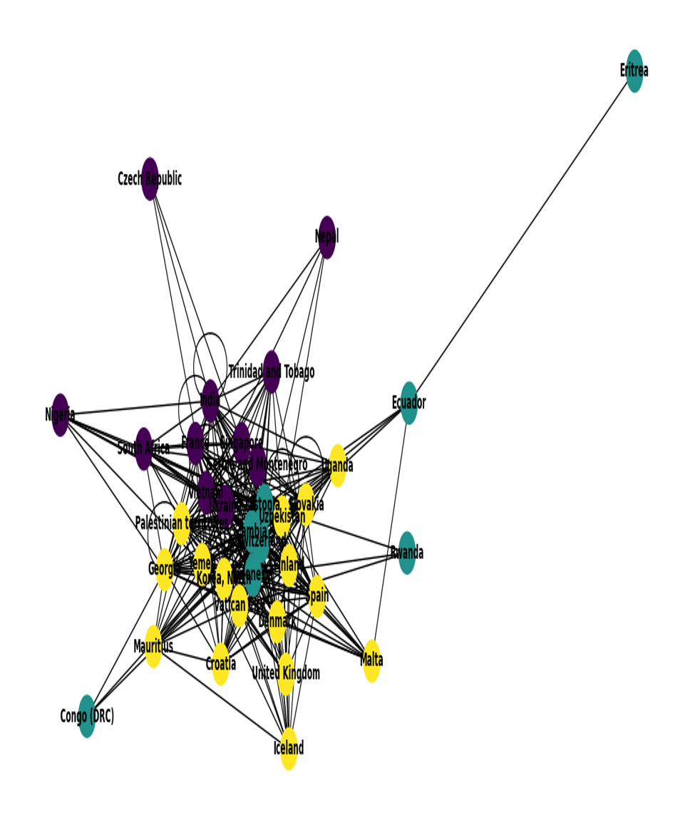
Louvain clustering
Fig 6.1:Graph using language translation weight as Edge Weight

Slide 18
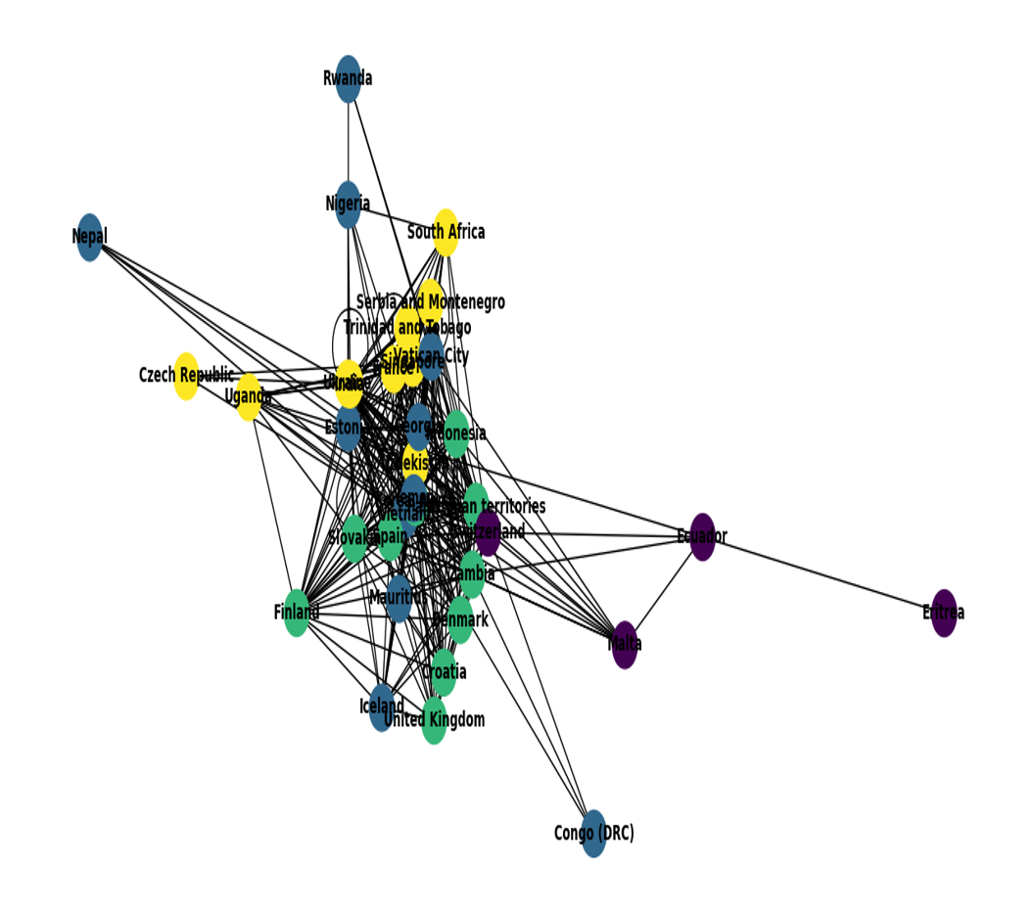
Louvain clustering
Fig 6.2:Graph using Geographical distance as edge weight

Slide 19
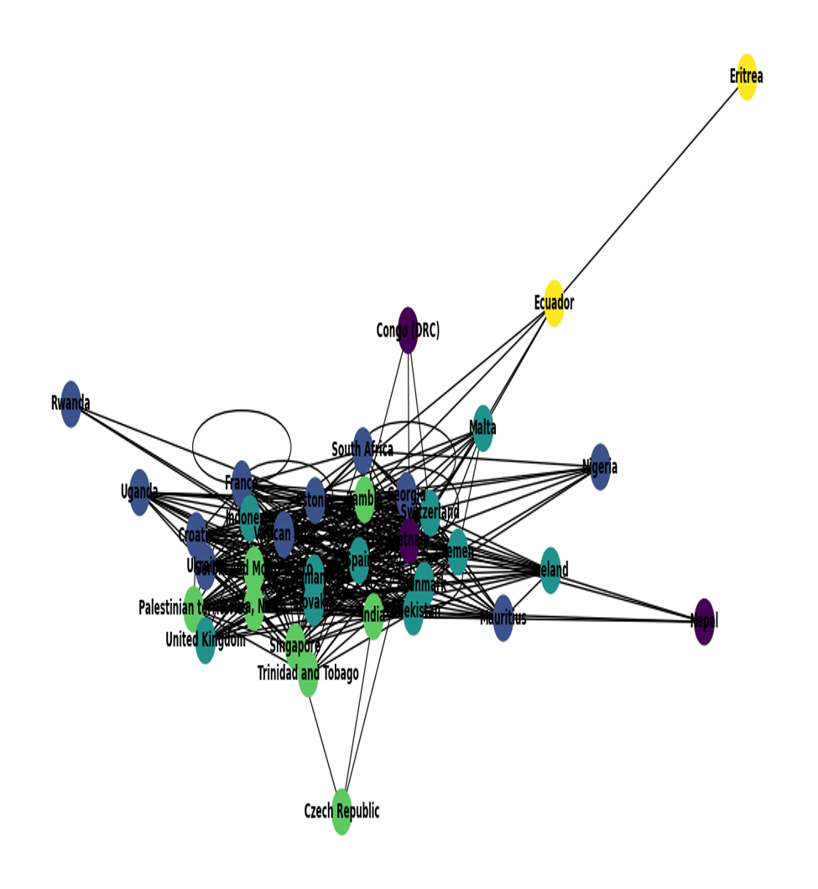
Louvain clustering
Fig 6.3: Graph using random distance as edge weight

Slide 20
CONCLUSION AND FUTURE SCOPE:
I.CONCLUSION:
This project tackled the digital language divide by investigating how geographical distance influences the translation of content across different Wikipedia language editions. The primary achievements of this research are:
1.Quantitative Measurement of Content Gaps
2.Geographical Analysis
3.Country-Language Mapping
4.Comprehensive Data Collection and Analysis
5.Graph Analysis and Community Detection

Slide 21
Future Scope:
The findings of this research open several avenues for future exploration and enhancement:
1.Expansion to Other Platforms
2.In-depth Cultural Analysis
3.Impact of Technological Advancements
4.Policy Recommendations
5.Longitudinal Studies

Slide 22
REFERENCES
1.Zhu, Kai, and Dylan Walker. "The Promise and Pitfalls of AI Technology in Bridging Digital Language Divide: Insights from Machine Translation on Wikipedia." Available at SSRN (2024).
2.Zhu, K., & Walker, D. (2024). The Promise and Pitfalls of AI Technology in Bridging Digital Language Divide: Insights from Machine Translation on Wikipedia. Available at SSRN.
3.Warncke-Wang, Morten, et al. "In search of the ur-Wikipedia: universality, similarity, and translation in the Wikipedia inter-language link network." Proceedings of the Eighth Annual International Symposium on Wikis and Open Collaboration. 2012.
4.Warncke-Wang, M., Uduwage, A., Dong, Z. and Riedl, J., 2012, August. In search of the ur-Wikipedia: universality, similarity, and translation in the Wikipedia inter-language link network. In Proceedings of the Eighth Annual International Symposium on Wikis and Open Collaboration (pp. 1-10).
5.Ngo, Quoc‐Hung, Son Doan, and Werner Winiwarter. "Using Wikipedia for extracting hierarchy and building geo‐ontology." International journal of Web information systems 8, no. 4 (2012): 401-412.
6.Ngo, Q.H., Doan, S. and Winiwarter, W., 2012. Using Wikipedia for extracting hierarchy and building geo‐ontology. International journal of Web information systems, 8(4), pp.401-412.

Slide 23
THANK YOU

Slide 24
Appendix
1.Quantum Jensen-Shannon Divergence (QuantumJSD):
For graphs,it quantifies the divergence between the distributions of node pair and egdes.
2.Degree Divergence:
Compares the degree distributions of two graphs.
3.Jaccard Distance:
Measures the dissimilarity between two sets. For graphs, it can compare the sets of neighbors for nodes.
4.Hamming Distance:
Measures the number of differing elements between two binary sequences. For graphs, it can compare edge presence/absence.
5.Hamming-Ipsen-Mikhailov Distance:
A hybrid metric combining aspects of Hamming and structural distances to measure differences between graphs.
6.Frobenius Norm:
Measures the difference between two matrices. For graphs, it often compares adjacency matrices.

Slide 25
Appendix
7.NetLSD (Network Laplacian Spectral Descriptor):
Network Laplacian Spectral Descriptor, a metric based on the spectral properties of the Laplacian matrix of the graph.
8.Graph Edit Distance:
Counts the minimum number of operations (additions, deletions, substitutions) required to transform one graph into another.
9.Spectral Distance:
Measures the difference between the eigenvalues of the Laplacian matrices of two graphs.
10.Shortest Path Distance:
The minimum number of edges required to travel from one node to another. This metric measures the divergence in shortest paths across different graph configurations.

Slide 26
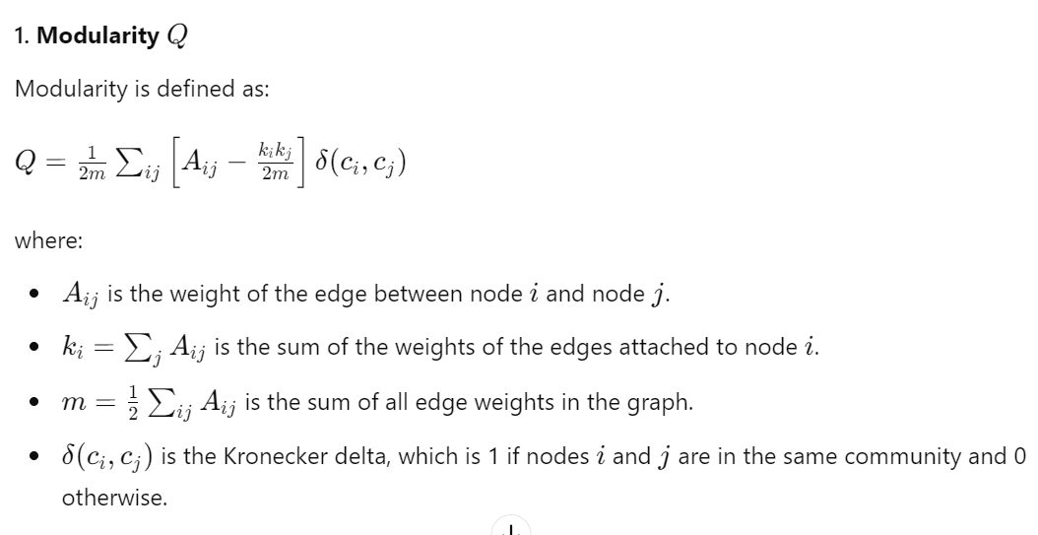
Appendix

Slide 27
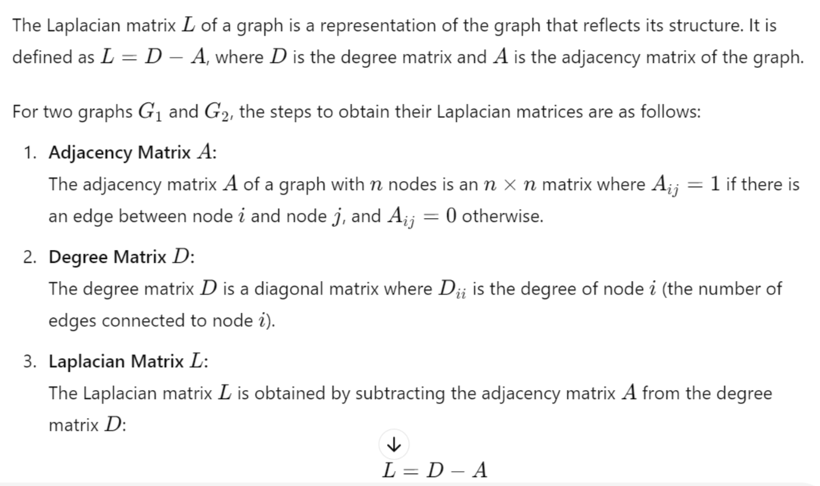
Appendix

